Slide 1




From Prey to Predator: A Use Case for Using Active Defense to Reshape the Asymmetrical Balance in Cyber Defense
Pei-Yu Huang, Washington University in St. Louis
Yi-Ting Huang, National Taiwan University of Science and Technology
Yea li Sun, National Taiwan University
Meng Chang Chen, Academia Sinica
Notes:
Good evening, ladies and gentlemen. I am Pei Yu, Huang, I am currently a graduate student at Washington University in St. Louis.
I would like to thank my supervisor Meng Chang Chen, from Academia Sinica, and co-authors Yi-Ting Huang from Taiwan Tech, and Yea li Sun from NTU. I am grateful for the resources and opportunities they have provided, which have greatly contributed to this study.
This study is mainly about showcasing how to implement active defense on a real-world attack using the MITRE Engage framework.

Slide 2
Outline
Main Idea
Background & Related Work
Use Case
Proposed Active Defense Implementations
Conclusion
Future Work
Q & A
Notes:
Today's presentation will cover the main idea of the research, followed by the Background and Related Work,
then the Use Case used to demonstrate how the cyberattack happened.
Next, I will talk about the proposed active defense implementations based on MITRE ATT&CK and Engage framework. And lastly, I will talk about future work that can refine and enhance the effectiveness of active defense mechanisms.

Slide 3
Outline
Main Idea
Background & Related Work
Use Case
Proposed Active Defense Implementations
Conclusion
Future Work
Q & A
Notes:
Let’s start with the main idea.

Slide 4
Main Idea
Cyber-security defenses predominantly rely on a passive approach of waiting for adversaries to match predefined rules.
Active defense involves actively engaging with adversaries to observe, affect, and elicit attack behaviors by providing deceptive information.
We analyzed the TTPs used in a real-world cyber-attack based on the MITRE ATT&CK® framework.
Then, using the identified TTPs and mapped to the MITRE Engage™ framework, we identified potential use cases for implementing active defense as a countermeasure.
Notes:
The current strategy in cyber-security defense largely revolves around a passive approach, where the focus is on waiting for attackers to trigger pre-determined rules. Therefore, the inherent asymmetry of cyber security puts the defense party at a significant disadvantage.
Active defense, on the other hand, re-balances the asymmetrical nature of cyber defense. It primarily involves actively engaging with attackers to observe, affect, and elicit attack behaviors by providing deceptive information.
Our analysis of a real-world cyberattack utilized the MITRE ATT&CK framework to examine the implemented techniques. Then, by mapping these techniques onto the MITRE Engage framework,
we identified potential use cases for implementing active defense.

Slide 5
Outline
Main Idea
Background & Related Work
Use Case
Proposed Active Defense Implementations
Conclusion
Future Work
Q & A
Notes:
Let’s move on to the background and related work

Slide 6




What is Active Defense?
With traditional “passive” defense,
the attacker only needs to be
right once
Under active defense techniques, the attacker only needs to be
wrong once
Secure Perimeters
Secure Perimeters
Secure Internal Network
Secure Internal Network
The IP and data within the domain are genuine, and once they are stolen, the attacker wins
Not all IPs and data are genuine.
Once stolen, there is no guarantee that the attacker wins
Source: https://engage.mitre.org/
Notes:
So, what is active defense?
Quoting from the MITRE Engage framework, “With traditional cyber defense, the attacker only needs to be right once, but with active defense, the attacker only needs to be wrong once.”
On the left-side, the castle represents the traditional defense, which makes sure the perimeter of the network is secured. However, the internal network is relatively vulnerable, it is difficult to detect malicious actors in real-time.
Plus, the IP and data within the domain are genuine, and once they are stolen, the attacker wins the battle.
Traditional defense methods such as Intrusion Detection Systems (IDS) and anti-viruses are signature-based and anomaly-based detections.
They spend huge efforts in finding malicious patterns.
The costs and time to identify false alarms and benign triggers can be substantial.
And let’s look at the right-hand side, we see that Active defense coupled with passive defense, serves as a complementary method to secure the internal network.
It is an action-based detection that can quickly identify abnormal interactions, resulting in higher-quality of reported data.
Plus, not all IPs and data are genuine, once stolen, there is no guarantee that the attacker wins.

Slide 7
Components of Active Defense
Cyber Denial
Prevent or impair the adversary’s ability to conduct operations
Limit their movements and collection efforts
Diminish the effectiveness of their capabilities.
Cyber Deception
Intentionally reveal deceptive facts and fictions to mislead the adversary
Conceal critical facts and fictions to prevent the adversary from taking appropriate actions
Notes:
So, active defense has two key components: cyber denial and cyber deception.
Denial is to prevent or impair the attacker’s ability to conduct operations.
To limit their movements, and collection efforts
And to diminish the effectiveness of their capabilities.
And Deception is to intentionally reveal deceptive facts and fiction to mislead the attacker.
And To conceal critical facts and fiction to prevent the attacker from forming correct estimations or taking appropriate actions.

Slide 8
Active Defense (Adversary Engagement)
Cyber denial + Cyber deception
Negatively impact the adversary
To expose adversaries on the network
To elicit intelligence to learn more about their attack Tactics, Techniques, and Procedures (TTPs)
To affect the adversary by impacting their ability to operate
Notes:
And active defense is when denial and deception are used together in a strategic way, which is also called adversary engagement, which is self-explanatory, that we are engaging with attackers.
The goal of active defense is to negatively impact the attacker.
This includes three main components:
First, To expose attackers on the network
Second, To elicit intelligence to learn more about their attack tactics, techniques, and procedures, also known as TTPs.
Third, To affect the attacker by impacting their ability to operate

Slide 9


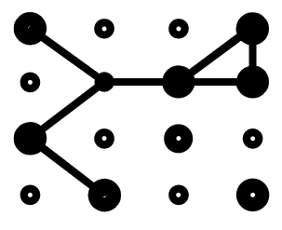

What can Active Defense do?
Reduce attackers' accuracy in distinguishing between genuine and fake systems.
Increase the chance of detecting intrusion in real-time.
Increase the time and cost required for attackers and add complexity.
Even if deception are not actually deployed, as long as attackers believe there are, desired effect can still be achieved.
Source: Ferguson-Walter, Kimberly J., Dana S. LaFon, and T. B. Shade. "Friend or faux: deception for cyber defense." Journal of Information Warfare 16, no. 2 (2017): 28-42. and Ferguson-Walter, Kimberly, Temmie Shade, Andrew Rogers, etc. "The Tularosa Study: An Experimental Design and Implementation to Quantify the Effectiveness of Cyber Deception." No. SAND2018-5870C. Sandia National Lab.(SNL-NM), Albuquerque, NM (United States), 2018.
Notes:
With existing research from the U.S. Department of Defense and the US National Security Agency, we know that active defense is able to reduce attacker’s certainty about what is and is not real
such that they wastes time and resources through attempts to increase their certainty.
Therefore, also increasing the overall chance of detecting intrusion in real-time.
What’s better is that, even if active defense are not being deployed, as long as the attackers believe there are, it still disrupts attackers’ operations effectively.

Slide 10
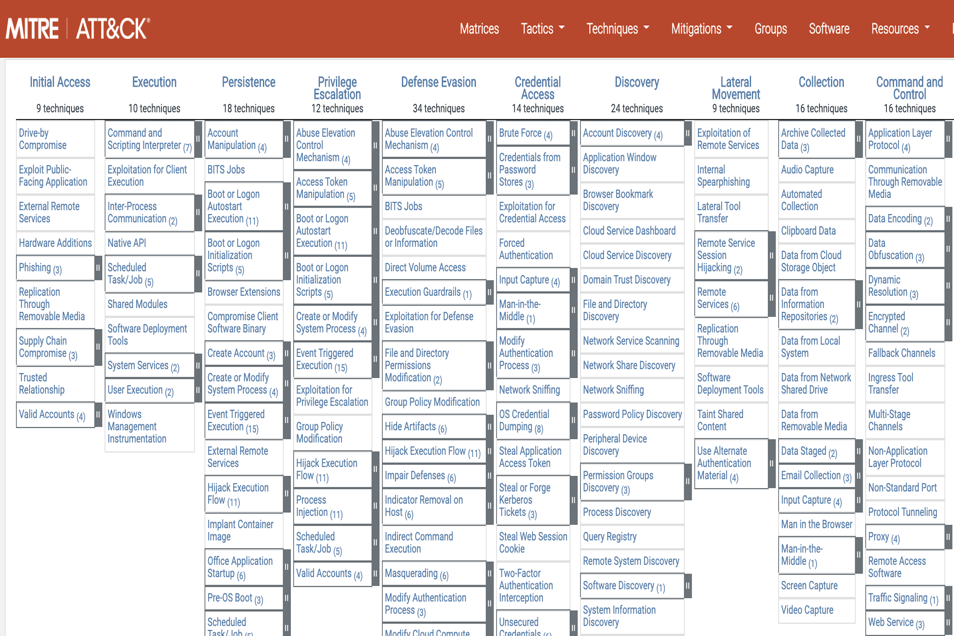
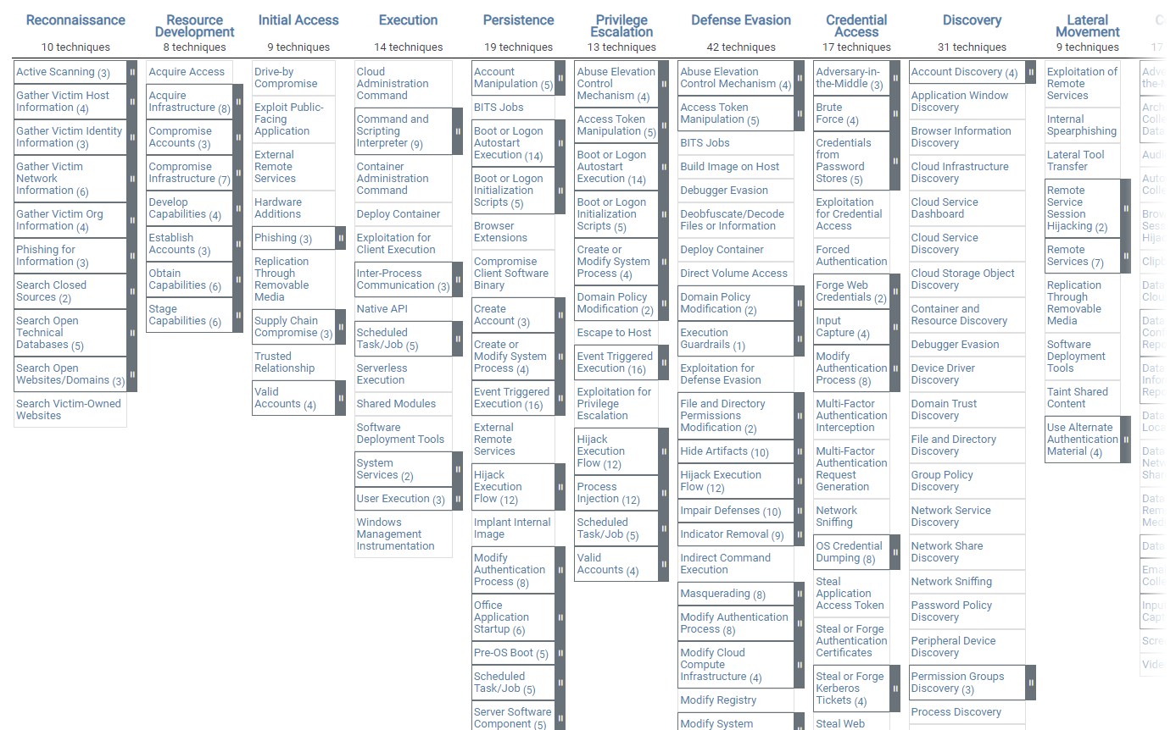

Tactics
Procedure Examples
TeamTNT has scanned specific lists of target IP addresses.
Techniques
With the identified TTPs from ATT&CK framework, we can then map what active defense to use from Engage framework.
*v11, Apr 2022
Notes:
To determine what active defense methods to use, we can seek assistance from the well-established MITRE ATT&CK framework, which provides a comprehensive set of Tactics, Techniques, and Procedures.
Tactic refers to the underlying purpose behind attack actions.
For example, reconnaissance refers to the stage where attackers gather information about the target victim before the attack.
Technique refers to the action performed to achieve a tactic. For example, the technique Active Scanning, which is a technique under reconnaissance, is where the attackers gain information by scanning victim’s infrastructure through network traffic.
And its procedure example shows that how this technique is being used.
So, with the identified TTPs from the ATT&CK framework, we then map what active defense methods to use from the Engage framework.

Slide 11
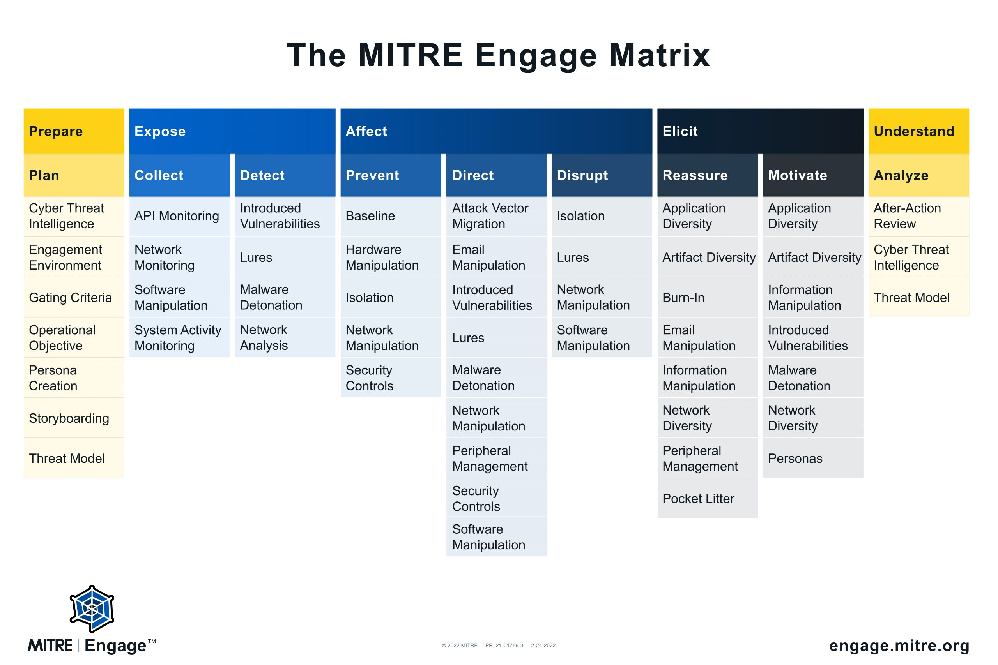
MITRE Engage Framework
5 Goals
9 Approaches
31 Activities
Deception
Denial
Notes:
Let’s take a quick look at the MITRE Engage framework.
It is a knowledge base of active defense, which assists defenders in understanding approaches to counter attackers.
The framework was introduced in April 2022, and it consists of five goals, nine approaches, and thirty-one activities.
The five goals are Prepare, Expose, Affect, Elicit, and Understand.
• Prepare and Understand are the inputs and outputs of active defense, which determine what active defense components to deploy and to revise after each attack.
Expose is to detect and send alerts when attackers are in the environment.
Affect is to negatively impact attackers’ actions and operations.
Elicit is to lure or trick attackers to perform more TTPs.
• Approaches represent the purposes of certain active defense activities.
• Activities are driven by real adversarial actions and represent how approaches are implemented.
Each activity can be either serving denial or deception purposes,
for example. Lures are deceptive systems and artifacts intended to serve as decoys, and isolation is to configure systems, and networks, preventing the expansion of an engagement beyond desired limits.

Slide 12
MITRE ATT&CK Framework
Tactic
Resource Development | Initial Access | Execution
Establish Accounts | Phishing | User Execution
Obtain Capabilities | Exploit Public-Facing Application | System Services
Technique
MITRE Engage Framework
Goal
Expose | Affect | Elicit
Collect | Direct | Reassure | Motivate
System Activity Monitoring | Email Manipulation | Pocket Litter | Personas
 |  | Email Manipulation
Approach
Activity
Notes:
This is an example of how phishing technique in the ATT&CK framework is able to map to the Engage framework.
The red table on the top is the ATT&CK framework, and the blue table below is the Engage framework.
Through mapping, we can see that the suggested active defense methods are System activity monitoring, email manipulation, pocket litter, and personas.
So, from the Engage framework, we know what active defense methods to deploy in advanced to prevent and mitigate potential attacks.

Slide 13
Outline
Main Idea
Background & Related Work
Use Case
Proposed Active Defense Implementations
Conclusion
Future Work
Q & A
Notes:
After knowing how the mapping works, let’s move on to the use case

Slide 14

Use Case: Cybersecurity Incident at CPC Taiwan
In May 2020, the Chinese Petroleum Corporation (CPC) in Taiwan, a natural gas corporation, fell victim to a ransomware.
Disrupted electronic transaction applications for half a month.
A targeted attack on Active Directory (AD)
We analyzed the tactics and techniques used in this incident based on the ATT&CK framework, and we identify possible active defense implementations based on the Engage framework.
Source: https://www.ithome.com.tw/news/139331
Notes:
To demonstrate the usage of active defense, we chose a notorious ransomware attack incident from Taiwan. In May 2020, the Chinese Petroleum Corporation (CPC), fell victim to a ransomware attack. Causing system outage.
The attack was a typical example of a targeted attack on Active Directory, also known as AD, which can be catastrophic for organizations’ operations if compromised.
We analyzed the tactics and techniques employed in this case based on ATT&CK framework, and we identify possible active defense implementations based on the Engage framework.

Slide 15










(1) Initial Access
T1190: Exploit Public-Facing Application
T1566: Phishing
DMZ
(1)
Firewall
Compromised Web server
(2) Command and Control (C2)
T1021: Remote Services
T1071: Application Layer Protocol
Extranet
Intranet
(3) Discovery
T1049: System Network Connections Discovery
T1018: Remote System Discovery
T1016.001: System Network Configuration Discovery: Internet Connection Discovery
T1046: Network Service Discovery
Data center
SOC
(2)
Switch
(3)
AD
(3) Credential Access & Collection
T1550: Use Alternate Authentication Material
T1056: Input Capture
(4)
(1)
(4) Persistence & Privilege Escalation
T1053.003: Scheduled Task/Job
Compromised PC
User PC
User PC
(4) Impact
T1486: Data Encrypted for Impact
Notes:
This is a simplified graph of how the attack happened. The process can be categorized into 4 sections.
Starting from the initial access, it was speculated that the attack originated from a compromised internal PC or web server. In the first case, attackers may try to sniff packets, scan for open ports, and then inject malicious scripts to gain access to the web server.
In addition, the second possibility may be through Phishing attacks. This includes sending fraudulent emails containing malicious links or attachments that, once clicked, deploy malware onto the system, giving the attacker an initial foothold in the network.
Next, Command and Control (C2). Once compromising an endpoint, attackers established a connection back to themselves.
Then,
When obtaining C2 connection, the attacker would start an internal scanning to
gather information to locate valuable assets.
And in this case, CPC’s AD was taken control.
Then,
Credential Access & Collection. Attackers were able to gain access to AD by posing as a legitimate user. Attackers extracted hashed credentials from compromised devices, then move laterally in the network by bypassing access controls.
Next,
Persistence & Privilege Escalation. After gaining access
to AD, the attackers went on to distribute ransomware. They forged a Group Policy Object and scheduled a task for all computers to download and execute the ransomware automatically.
Lastly,
Impact.
On the next morning, when the employee booted their PCS,
the ransomware was downloaded and executed on all PCs as scheduled.
Then, files were encrypted, and CPC received a message to pay for the decryption key.
This step also marked the completion of the APT mission.
We took these four stages as an example to demonstrate the deployment of active defense.

Slide 16
Outline
Main Idea
Background & Related Work
Use Case
Proposed Active Defense Implementations
Conclusion
Future Work
Q & A
Notes:
So, let’s move on to how these measures can be implemented based on the Engage framework.

Slide 17
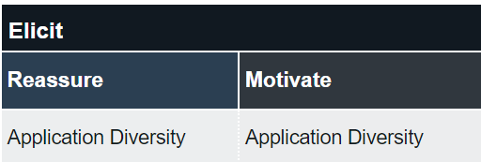

Initial Access: Exploiting Web Server
Application Diversity
Mixes decoy web servers that mimics the legitimate server
Network Manipulation
Decoy web server interacts with the adversary and alert the security team
Introduced Vulnerabilities
Redirect the adversary from the real server and gather information about their capabilities and resources
Reveal targeting preferences, available capabilities, or even to influence future targeting decisions
Notes:
In inital access, let’s take web server exploitation as an example.
The goals and approaches of each Engage activity are placed beside.
Attackers may leverage scanning tools to identify open ports of web servers.
To counter this, defenders can set up multiple decoy web servers and mix them in the environment. Any connection to them will immediately be considered malicious, given that no regular users are able to connect to the decoys.
Through Network Manipulation, the decoy web server can interact with the attacker and alert the security team.
Defenders can also introduce Vulnerabilities to redirect the attacker from the real server and reveal their targeting preferences.
These methods allow defenders to receive alerts before the attacker can penetrate the system.

Slide 18

Discovery
Software Manipulation
Decoy Endpoint
Decoy AD
Pocket Litter
Decoys provides fake information, such as IP addresses and domain account names
Network Manipulation
Install a module at the endpoints that monitor any scans directed to a closed port
Scans sent to a non-existent device or service are deemed suspicious
Notes:
At the stage of Discovery.
This can be countered by setting decoy endpoints mixing in the environment
and decoy AD diverting suspicious sources to an isolated environment.
The decoys would keep interacting with the attackers and feed them fake credentials to elicit more behaviors.
Defenders can install a module at the endpoints that monitor any scans directed to a closed port.
This means that scans sent to a non-existent device or service are deemed suspicious.

Slide 19

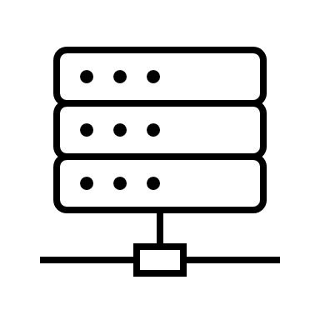


Decoy Endpoint: Obfuscating Ports Scans
Port 53?
Web server (port 80)
Decoy web server
Port 80?
Deception Engagement Server
Decoy DNS server
DNS server (port 53)
Quarantine
Decoys
Source: Sentinel.com
Notes:
For example, port 80 is typically used for web services, while port 53 is used for DNS servers. If
an IP address attempts to scan port 53 on a web server,
or
an IP address attempts to access port 80 on a DNS server
,an alert is generated to indicate abnormal scans on the network.
The module then redirects the query to a decoy server pretending to be the service that attackers were asking for.
The suspicious source would be quarantined for further observation.

Slide 20



Decoy AD: Active Directory Intercept on endpoint
Redirect
Initial Access
Sandbox
Compromised PC
Discovery
Detect suspicious query
Respond with fake AD objects
AD with active defense
Decoy AD
Source: Sentinel.com
Notes:
And for the decoy AD,
the attacker performs discovery on valuable assets,
the real AD with active defense software detects and alerts unauthorized queries.
Then, the decoy AD is activated, and the connection to the real AD would be blocked.
So the real information would be kept from the suspicious source.
Decoy AD would provide fake AD objects, such as IP addresses and domain account names, that appear genuine enough to maintain a realistic environment and misdirect attackers away from systems.
The fake credentials would make them believe they are still in the real network and being unnoticed.
And we can further observe the actions and strategy that the attackers have, and therefore have a better understanding of future attacks.

Slide 21


Credential Access & Collection
Information Manipulation
Place fake credentials
Usernames, passwords, and access keys by extracting password hash from either memory or hard disks (e.g., account manager or password/shadow file).
Security Controls
Alter security controls to make the system more or less vulnerable to attack.
Modifying Group Policies, disabling or enabling autorun for removable media, tightening or relaxing system firewalls.
Pocket Litter
Browsing history, pictures, installed software, and connection history.
Decoy files mixed with non-essential real files and encrypted using base64 or Advanced Encryption Standard (AES)
Notes:
Credential Access & Collection.
In the event that attackers gain control of the AD as an authorized user, it is common for attackers to try obtain information such as usernames, passwords, and tokens by extracting password hash from either memory or hard disks.
Defenders can strategically place fake credentials in these locations, and intentionally making them appear vulnerable or challenging to crack.
If these decoys are used, alerts are triggered.
Once defenders detect suspicious activity in the network, they can leverage Security Controls, such as modifying login policies, to make it easier for the attacker to log in to monitored environments.
Also, the credibility of decoy endpoints can be improved by providing them with Pocket Litters such as browsing history and connection history.
Moreover, decoy files can also be mixed with non-essential real files and encrypted using base64 or Advanced Encryption Standard (AES) to enhance their credibility.
For each step, they need to verify whether the credentials are legitimate and simultaneously avoid possible traps with exceptional caution.

Slide 22

Impact- The last resort
Artifact Diversity
Display various system artifacts, such as browser cookies, directories.
Any decoy files are modified means that ransomware has been executed.
Information Manipulation
Redirected to a VM and isolated from the system network.
The VM would contain decoy files, such as .doc, .xlsx, .pdf, and .mp4, are included, exceeding the quantity of actual files by one hundred times.
Slow down encryption rate and create the appearance that it is still carrying out its intended function.
Notes:
Lastly,
Impact. This is the scenario in which ransomware has been executed successfully and has begun encrypting data.
It is the last resort for defenders to detect this activity if none of the active defense measures were deployed during the earlier stages.
To increase the chances of detecting ransomware activity, defenders can display various system artifacts, such as browser cookies and directories.
where all of these artifacts are closely monitored for any interactions. If any decoy files are modified, this indicates that ransomware has been executed.
Concurrently, the ransomware is redirected to a VM and isolated from the system network. The VM would contain decoy files, such as document, excel and pdf files.
These files exceed the number of actual files by one hundred times.
This slows down the ransomware’s encryption rate and creates the appearance that it is still carrying out its intended function.

Slide 23
DMZ
Initial Access
EAC0006: Application Diversity
EAC0016: Network Manipulation
EAC0023: Introduced Vulnerabilities
Decoy
Web server
Extranet
Firewall
Web server
Discovery
EAC0011: Pocket Litter
EAC0014: Software Manipulation
EAC0016: Network Manipulation
Intranet
Data center
Decoy data
SOC
Credential Access & Collection
EAC0011: Pocket Litter
EAC0015: Information Manipulation
EAC0018: Security Controls
Switch
Decoy AD
AD
Impact
EAC0015: Information Manipulation
EAC0022: Artifact Diversity
Decoy endpoint
Endpoint
User PC with decoy data
Notes:
This is an overview of the Engage activities being mapped, along with the corresponding deployment of active defense methods.
First, the initial access can be defended by setting up decoy web server.
Second, having decoy endpoints and decoy AD can detect malicious scans during the Discovery stage.
Next, decoy data among endpoints can deceive attackers when they use credential access & control and also during impact.

Slide 24
Outline
Main Idea
Background & Related Work
Use Case
Proposed Active Defense Implementations
Conclusion
Future Work
Q & A
Notes:
To conclude,

Slide 25
Conclusion
With CPC’s APT attack scenario, we examined attack techniques employed based on ATT&CK framework.
We proposed various active defense strategies utilizing denial and deception techniques based on Engage framework.
Active defense enhances the overall security posture of the internal network.
Active Defense is still a relatively novel concept, but the adoption of engagement, denial, and deception by the defensive side is undoubtedly becoming a prominent future trend.
Notes:
By analyzing CPC's APT attack scenario, we assessed the attack techniques employed by utilizing the ATT&CK framework.
Then, based on Engage framework, we put forth a range of active defense strategies that leverage denial and deception techniques.
Implementing these measures not only mitigates the risk of similar incidents like CPC but also enhances the overall security posture of the internal network.
Active Defense, while still a relatively new concept in cybersecurity, has the potential to shape the future of defensive strategies.

Slide 26
Outline
Main Idea
Background & Related Work
Use Case
Proposed Active Defense Implementations
Conclusion
Future Work
Q & A
Notes:
Lastly, our future work.

Slide 27
Future Work
Currently, we are working with Acer on the implementations
Interface
Report systems
Gathering real-life data to evaluate the effectiveness of the implementations.
Further research would focus on resource requirements, operational overheads, and potential scalability challenge.
Notes:
Despite the unfortunate outcome of this paper not being accepted, we highly value the insightful comments provided by the reviewers.
In light of the feedback, our future work will continue gathering additional real-life data to assess the effectiveness of these implementations.
Specifically, the focus will be on evaluating the cost and resource requirements, which are critical factors that influence the potential scalability of active defense mechanisms.

Slide 28
Q & A
Contact info:
Pei Yu, Huang h.peiyu@wustl.edu
Yi-Ting Huang ythuang@mail.ntust.edu.tw
Notes:
This is the end of my presentation, and I welcome any question.

Slide 29
Thank you!

Slide 30
Appendix

Slide 31


Initial Access: Phishing Attack
EAC0009: Email Manipulation
Decoy emails are placed on orphan pages
When decoy emails receive any messages, block the associated email addresses and IPs to prevent employees from viewing them.
EAC0012: Persona
A fake employee profile on a social media platform like LinkedIn, complete with a decoy email address.
EAC0011: Pocket Litter
Hobbies, personal, professional interactions, profile data, and updates

Slide 32

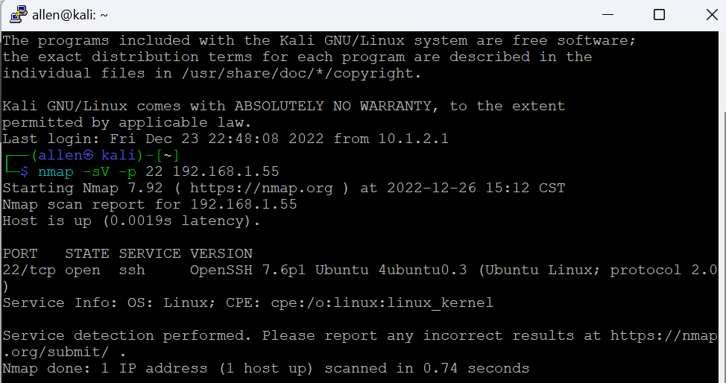
Appeared as Linux OS with SSH open for connection
Windows PC without SSH connection

Slide 33
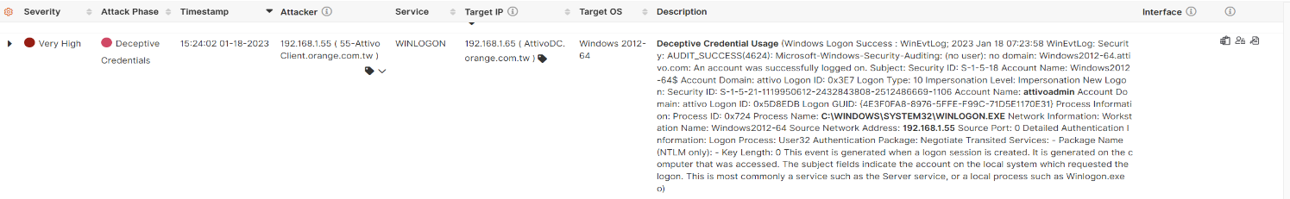

Slide 34
Potential Utilized Attack Techniques
Discovery
T1049: System Network Connections Discovery
T1018: Remote System Discovery
T1016.001: System Network Configuration Discovery: Internet Connection Discovery
T1046: Network Service Discovery
Initial Access
T1190: Exploit Public-Facing Application
T1566: Phishing
Command and Control
T1021: Remote Services
T1071: Application Layer Protocol
Impact
T1486: Data Encrypted for Impact
Persistence & Privilege Escalation
T1053.003: Scheduled Task/Job
Credential Access & Collection
T1550: Use Alternate Authentication Material
T1056: Input Capture

